Slide 1
E-Books for
Fostering Academia-Industry Collaboration
in Food Safety and Quality
FoodQA
3rd Management Meeting
Porto, Portugal
January 22-24, 2018
Leipzig University of Applied Sciences
Dr. Riyadh Qashi & M.Sc. Alex Dekin
Project Nr 574010-EPP-1-2016-1-JO-EPPKA2-CBHE-JP

Slide 2
Content
Definition E-Books
Key elements of the E-book development and usage
Contribution to the E-Books development from the FoodQA Partners
E-Books development for FOODQA (HTWK Leipzig)
Technical aspects: how to read and edit E-books:
on your PC?
on your smartphone or tablet (iOS/Android)?
Dr. Riyadh Qashi
Project Nr 574010-EPP-1-2016-1-JO-EPPKA2-CBHE-JP

Slide 3
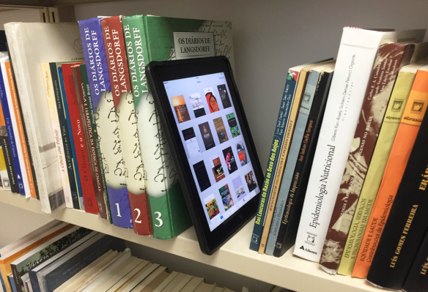
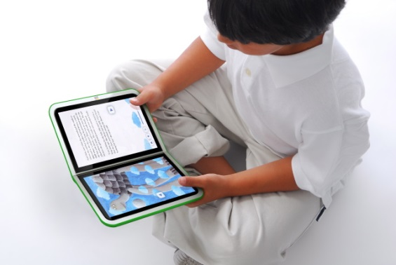
Definition E-Books?
An electronic book (or E-book) is a book publication made available in digital form, consisting of text, images, or both, readable on the flat-panel display of computers and other digital devices
E-Books can be viewed on specially dedicated hardware devices known as e-Readers or e-Book devices. Personal computers , Tablets, Smartphones and some cell phones can also be used to read e-Books.
Dr. Riyadh Qashi
Project Nr 574010-EPP-1-2016-1-JO-EPPKA2-CBHE-JP

Slide 4
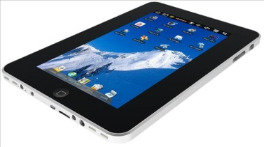
Key elements of the E-book development and usage
E-book hardware (PC’s, Laptops, Tablets, Smartphones, etc.)
E-book software - Readers (Adobe Acrobat, MobilePacket, TK3 Reader, etc.)
Converting to E-book format (Acrobat, Calibre, etc.)
E-publishers and booksellers (Amazon, Google and many more)
Common Coding Standards (.HTML, .OEB, .XML, .PDF, .PDB, .TEXT, .MOBI, .EPUB)
Copyright/security issues and publishing rights
Ownership relationships between readers and publishers
Changes of content in E-books
Copyrights
Future trends (what about the standards and compatibilities)
Dr. Riyadh Qashi
Project Nr 574010-EPP-1-2016-1-JO-EPPKA2-CBHE-JP

Slide 5
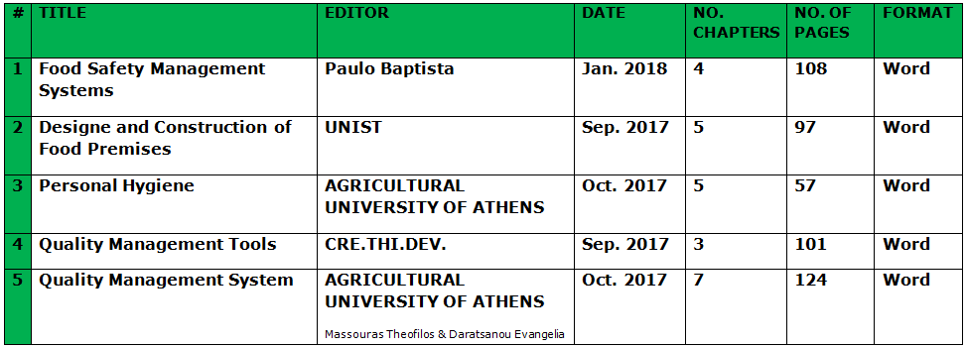
Contribution to the E-Books development from the FoodQA Partners
Dr. Riyadh Qashi
Project Nr 574010-EPP-1-2016-1-JO-EPPKA2-CBHE-JP

Slide 6
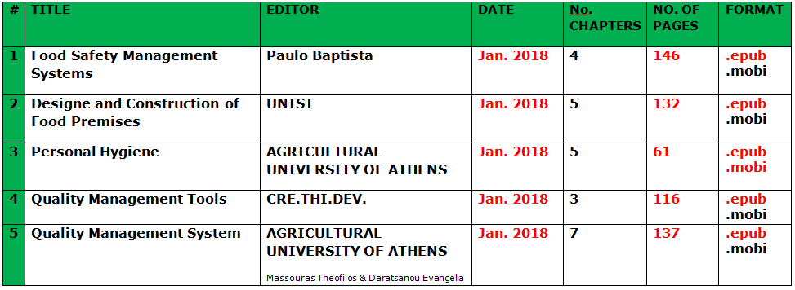
E-Books development for FOODQA (HTWK Leipzig)
Dr. Riyadh Qashi
Project Nr 574010-EPP-1-2016-1-JO-EPPKA2-CBHE-JP

Slide 7
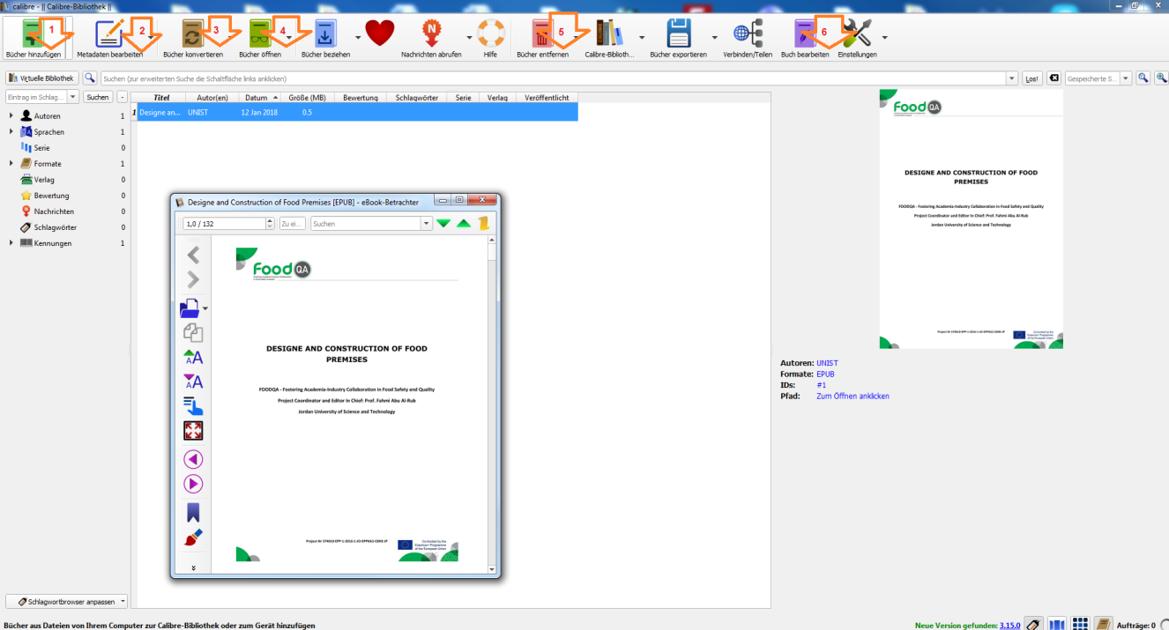
Technical aspects: how to read and edit E-books on your PC?
Online: Google search for:
e-books converter, e-books reader, on Microsoft or iOS devices
(additionally .epub reader / .epub converter)
Offline: PC: Download an E-books software e.g. Calibre (open source). With Calibre you can: edit your e-book, convert it and save it in .epub format
1 add book
2 edit metadata
3 convert book
4 open and view
5 delete book
6 edit book
7 save or export
Dr. Riyadh Qashi
Project Nr 574010-EPP-1-2016-1-JO-EPPKA2-CBHE-JP

Slide 8
Technical aspects: how to read and edit E-books on your smartphone or tablet?
iOS: iPad, iPhone
There are many Apps to read E-books such as Bluefire Reader, Ebook Reader, etc.
Android: Samsung, Nokia
As well numerous amount of Apps to read E-books such as Lithium - EPUB-Lese-App, Moon + Reader ,etc.
Bluefire Reader
EBook Reader,
Lithium - EPUB-Lese-App
Moon + Reader
Dr. Riyadh Qashi
Project Nr 574010-EPP-1-2016-1-JO-EPPKA2-CBHE-JP

Slide 9
Many thanks!
Dr. Riyadh Qashi
Project Nr 574010-EPP-1-2016-1-JO-EPPKA2-CBHE-JP

