Slide 1





Slide 2
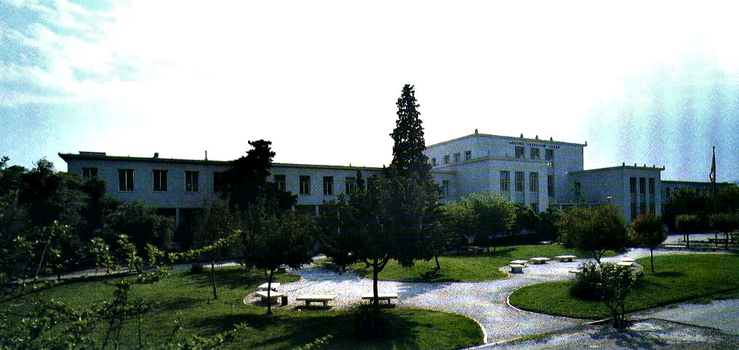

Slide 3
Evangelia Daratsanou, Business Consultant, Quality Manager

Slide 4
1. Quality management systems (ISO 9001:2015)
Rationale for QMS – The Learning Organization
Quality management (QM) is the use of management techniques and tools to achieve consistent quality of products and services, i.e. to achieve maximum customer satisfaction at the lowest overall cost to the organization while continuing to improve the process.
Notes:
With simple words a QMS is a structured collection of policies, procedures, policies and their associated responsibilities.

Slide 5
1. Quality management systems (ISO 9001:2015)
Rationale for QMS – The Learning Organization
Quality management is the basis for growth for all organizations
Continual change such as technological developments or the increasing competition, impose huge pressure on organizations
Organizations must constantly change in order to adapt to their markets as efficiently as possible
Development of knowledge is, also, a prerequisite for the development and evolution of an organization in the market.

Slide 6
1. Quality management systems (ISO 9001:2015)
Rationale for QMS – The Learning Organization
QMS are not just about a reaction to short-term crisis
A QMS is always a long-term process. QMS is part of over-all business.
For this reason, a properly functioning quality management creates the necessary structure for continuous growth in order to enhance customer satisfaction and thus success in the market.

Slide 7
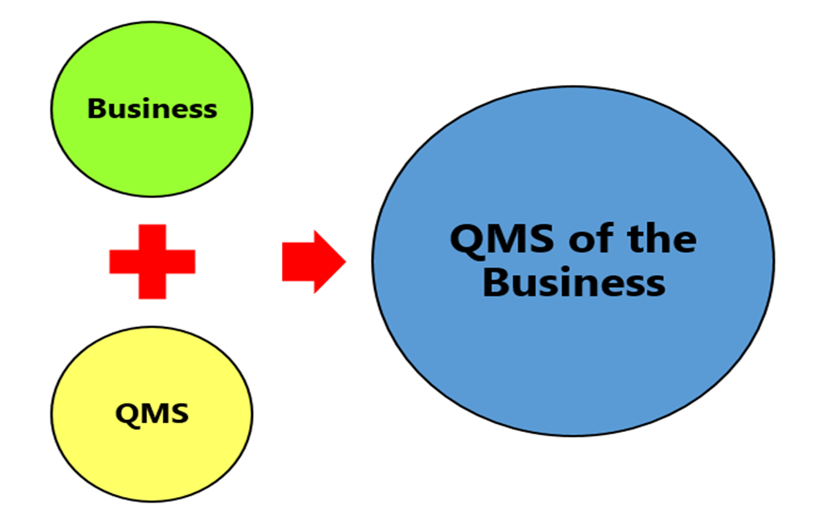
1. Quality management systems (ISO 9001:2015)

Slide 8
1. Quality management systems (ISO 9001:2015)
The International Organization for Standardization (ISO), is an independent, nongovernmental organization
ISO, through its 163 member organizations, brings together experts ―to share knowledge and develop voluntary, consensus-based, market relevant International Standards that support innovation and provide solutions to global challenges.
ISO has published 21,780 International Standards and related documents, covering almost all aspects of technology and every sector of manufacturing, including food safety.

Slide 9
1. Quality management systems (ISO 9001:2015)
Rationale for QMS – The Learning Organization
ISO is derived from the Greek word isos, meaning equal. Whatever the country, whatever the language, we are always ISO.
ISO 9001 sets out the requirements for a quality management system. It helps businesses and organizations to be more efficient and improve customer satisfaction.
ISO 9001, is applicable to any kind and type of organization.

Slide 10
1. Quality management systems (ISO 9001:2015)
Rationale for QMS – The Learning Organization
The International Standard ISO 9001 is an internationally recognized, credible and proven basis for the implementation of Quality Management.
Throughout the world, it promotes the further development of organizations and creates confidence in the relationships between companies, customers and suppliers. In 2013, 1,138,155 ISO 9001 certificates were issued in 187 countries. This corresponds approximately to 3/4 of all ISO certificates
Notes:
Numbers speak for themselves:

Slide 11
1. Quality management systems (ISO 9001:2015)
Rationale for QMS – The Learning Organization
As Govind Ramu, chair of the ISO 9001:2015 U.S., quotes “ISO 9001:2015 is not a giant, scary monster. It’s a commonsense approach to running any organization”.
Notes:
Numbers speak for themselves:

Slide 12
1. Quality management systems (ISO 9001:2015)
Development of QMS over time
In September 2015, a revised version – ISO 9001:2015 – was launched to bring the standard up to date, reflecting latest quality management good practice. Whilst some requirements have been tightened, the standard is now far less prescriptive and has even greater integration with other ISO management standard thanks to a common high-level structure.

Slide 13
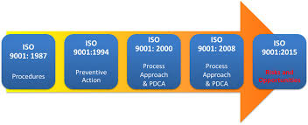
1. Quality management systems (ISO 9001:2015)
Development of QMS over time

Slide 14
2. Structure & Requirements of Standard ISO 9001:2015

Slide 15
1. Quality management systems (ISO 9001:2015)
According to the ISO, ISO 9000, ISO ­9001 and related ISO quality management standards are based on seven Quality Management Principles (QMPs).
The revised version of ISO 9001:2015 Standard, is based on the following Seven principles of Quality management:
QMP 1 – Customer focus
QMP 2 – Leadership
QMP 3 – Engagement of people
QMP 4 – Process approach
QMP 5 – Improvement
QMP 6 – Evidence-based decision making
QMP 7– Relationship management
The seven Quality Management Principles

Slide 16
1. Quality management systems (ISO 9001:2015)
The seven Quality Management Principles
7 Quality Management Principles
Customer Focus
Leadership
Engagement of People
Process Approach
Improvement
Evidence Based decision Making
Relationship Management

Slide 17
1. Quality management systems (ISO 9001:2015)
QMP 1 – Customer focus
“The primary focus of quality management is to meet customer requirements and to strive to exceed customer expectations” (ISO 9000: 2015)
According to the American Management Association (ama), as the knowledge economy evolves into an “experience economy,” successful firms will be those that can deliver better customer experiences by using empathy skills to build new brands or develop new consumer experiences.
The seven Quality Management Principles

Slide 18
1. Quality management systems (ISO 9001:2015)
QMP 1 – Customer focus - Rationale
Understanding current and future needs of customers and other interested parties contributes to sustained success of an organization”. (ISO 9000: 2015)
The seven Quality Management Principles

Slide 19
1. Quality management systems (ISO 9001:2015)
QMP 1 – Customer focus – Sources
Organizational Sources: Data, facts and figures gathered from the organization, especially from the “front – line” employees, or from on-line assessments and questionnaires by the end-users
Experiential Sources: The professional experience and judgment of executives and employees
Stakeholder Sources: The values, concerns and organizational decisions of people who are involved in the organization
Scientific evidence: Findings from published scientific research regarding customer focus concept
The seven Quality Management Principles

Slide 20
1. Quality management systems (ISO 9001:2015)
QMP 2 – Leadership
“Leaders at all levels establish unity of purpose and direction of the organization”. They should motivate their employees in order to aspire the company’s mission and goals.
They should, also, create and maintain the internal environment in which people can become fully involved in achieving the organization objectives."
The seven Quality Management Principles

Slide 21
1. Quality management systems (ISO 9001:2015)
QMP 2 – Leadership - Rational
Creation of unity of purpose and direction and engagement of people enable an organization to align its strategies, policies, processes and resources to achieve its objectives.
The seven Quality Management Principles

Slide 22
1. Quality management systems (ISO 9001:2015)
QMP 2 – Leadership - Sources
Experiential Sources: The professional experience and judgment of executives and top management
Stakeholder Sources: The values, concerns and organizational decisions of people who are involved in the organization
Scientific evidence: Findings from published scientific research regarding leadership concept
Academic Background: Relevant studies, vocational training, seminars and life - long learning, professional development.
The seven Quality Management Principles

Slide 23
1. Quality management systems (ISO 9001:2015)
QMP 3 – engagement of people
The term engagement originally referred to “how fully people are psychologically present during particular moments of role performance
An Organization must ensure that their employees have the enthusiasm and “know-how” to facilitate a smooth 9001 implementation and continued performance
It is essential for the organization that all people are competent, empowered and engaged in delivering value. Competent, empowered and engaged people throughout the organization enhance its capability to create value.
The seven Quality Management Principles

Slide 24
1. Quality management systems (ISO 9001:2015)
QMP 3 – engagement of people- Rationale
To manage an organization effectively and efficiently, it is important to involve all people at all levels and to respect them as individuals. Recognition, empowerment and enhancement of skills and knowledge facilitate the engagement of people in achieving the objectives of the organization.
The seven Quality Management Principles

Slide 25
1. Quality management systems (ISO 9001:2015)
QMP 3 – engagement of people- Sources
1- Organizational Sources: Data, facts and figures gathered from the organization, especially from the “front – line” employees, or from on-line assessments and questionnaires by the end-users
2- Experiential Sources: The professional experience and judgment of executives and employees
3- Stakeholder Sources: The values, concerns and organizational decisions of people who are involved in the organization
The seven Quality Management Principles

Slide 26
1. Quality management systems (ISO 9001:2015)
QMP 3 – engagement of people- Typical Actions
Engagement of people. Creating value for your customers will be easier if you have competent, empowered and engaged people at all levels of your business or organization.
Communicate with people to promote understanding of the importance of their individual contribution.
Promote collaboration throughout the organization.
Facilitate open discussion and sharing of knowledge and experience.
Empower people to determine constraints to performance and to take initiatives without fear.
Recognize and acknowledge people’s contribution, learning and improvement.
Enable self-evaluation of performance against personal objectives.
Conduct surveys to assess people’s satisfaction, communicate the results, and take appropriate actions.
The seven Quality Management Principles

Slide 27
1. Quality management systems (ISO 9001:2015)
QMP 3 – engagement of people- Key benefits
• Improved understanding of the organization’s quality objectives by people in the organization and increased motivation to achieve them
• Enhanced involvement of people in improvement activities
• Enhanced personal development, initiatives and creativity
• Enhanced people satisfaction
• Enhanced trust and collaboration throughout the organization
• Increased attention to shared values and culture throughout the organization
The seven Quality Management Principles

Slide 28
1. Quality management systems (ISO 9001:2015)
QMP 4 – PROCESS APROACH
The process approach was first introduced in ISO 9001:2000. And while the concept of a process-based quality management has not changed, the requirements in the latest version of the standard, ISO 9001:2015, have become more specific and less ambiguous.
So, what actually is a process approach? And why is it important? And, most importantly, how can you get your employees to apply it?
The seven Quality Management Principles

Slide 29
1. Quality management systems (ISO 9001:2015)
QMP 4 – PROCESS APROACH – Rationale
A process is a set of interrelated activities that transform activity inputs into outputs.
Quality management systems consist of interrelated processes. Understanding how those results are produced by any of these systems enables an organization to optimize the specific system and its actual performance.
The seven Quality Management Principles

Slide 30
1. Quality management systems (ISO 9001:2015)
QMP 4 – PROCESS APROACH – Rationale
The process approach is a management strategy which incorporates the plan-do-check-act cycle and risk-based thinking. It means that processes are managed and controlled. It also means that we not only understand what the core processes are, but we also consider how they fit together.
The seven Quality Management Principles

Slide 31
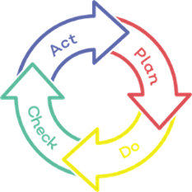
1. Quality management systems (ISO 9001:2015)
QMP 4 – PROCESS APROACH – Rationale
The seven Quality Management Principles

Slide 32
1. Quality management systems (ISO 9001:2015)
QMP 4 – PROCESS APROACH – Rationale
The requirement to "establish, implement, maintain and continually improve" is familiar from both ISO 9001:2000 and ISO 9001:2008. The key changes are:
For organizations already adopting ISO 9001:2008, a key factor in transitioning to ISO 9001:2015 is the extent to which the process approach has been adopted.
Clause 4.4 of ISO 9001:2015 sets out specific requirements for the adoption of a process approach. Organisations must monitor, measure and use related performance indicators to determine effective operation and controls.
Top management must promote, engage and support employees to follow a process approach.
The seven Quality Management Principles

Slide 33
1. Quality management systems (ISO 9001:2015)
QMP 4 – PROCESS APROACH – Rationale
Using a process approach in a quality management system facilitates:
understanding and consistency in meeting requirements,
viewing processes in terms of value-add,
achieving effective process performance,
improving process performance based on analysis and evaluation of the data and information.
- The process approach introduces horizontal management, controlling processes which flow across departmental boundaries.
- An employee’s first loyalty is to their assigned projects, products or services - rather than their own departments.
- They understand what the stakeholders involved in the process want and have delegated authority to act, so as to achieve this.
The seven Quality Management Principles

Slide 34
1. Quality management systems (ISO 9001:2015)
QMP 4 – PROCESS APROACH – Sources
Organizational Sources: Data, facts and figures gathered from the organization
Experiential Sources: The professional experience and judgment of executives and employees, previous processes involved
Stakeholder Sources: The values, concerns and organizational decisions of people who are involved in the organization
The seven Quality Management Principles

Slide 35
1. Quality management systems (ISO 9001:2015)
QMP 4 – PROCESS APROACH – Typical Actions
ISO 9001:2015 employs the process approach, which incorporates the Plan-Do-Check-Act (PDCA) cycle and risk-based thinking. This means the organization needs to:
determine required process inputs and expected outputs,
assign responsibilities and authorities for processes,
identify risks and opportunities for processes, and plan to address them in an optimum way.
The seven Quality Management Principles

Slide 36
1. Quality management systems (ISO 9001:2015)
QMP 4 – PROCESS APROACH – Typical Actions
Some processes’ examples:
internal training, leadership and performance evaluation,
manufacturing, design, distribution, development, service, delivery and assembly management,
business process outsourcing,
customer management,
equipment management,
supplier approval and re-evaluation,
risk identification and management,
contract change or revenue assurance management,
complaint handling,
information management, audits and inspections
The seven Quality Management Principles

Slide 37
1. Quality management systems (ISO 9001:2015)
QMP 4 – PROCESS APROACH – Key Benefits
• Enhanced ability to focus effort on key processes and opportunities for improvement
• Consistent and predictable outcomes through a system of aligned processes
• Optimized performance through effective process management, efficient use of resources, and reduced cross-functional barriers
• Enabling the organization to provide confidence to interested parties as to its consistency, effectiveness and efficiency
The seven Quality Management Principles

Slide 38
1. Quality management systems (ISO 9001:2015)
QMP 5 – IMPROVEMENT
“Successful organizations have an ongoing focus on improvement”. (ISO Org.)
Organizational Improvement is a dynamic and continuous process, that involves everyone within the organization from top management, to managers, and employees.
The seven Quality Management Principles

Slide 39
1. Quality management systems (ISO 9001:2015)
QMP 5 – IMPROVEMENT - RATIONALE
“Improvement is essential for an organization to maintain current levels of performance, to react to changes in its internal and external conditions and to create new opportunities”. (ISO Org.)
Organizational improvement is a prerequisite for any company or organization in order to operate as effectively as possible.
The seven Quality Management Principles

Slide 40
1. Quality management systems (ISO 9001:2015)
QMP 5 – IMPROVEMENT - RATIONALE
The organization should employ a consistent organization-wide approach to improvement of the organizations’ methods, tools and metrics for improvement.
The organization should provide people with the appropriate training in the methods and tools for improvement on an on-going basis. The organization should, also, make improvement of products, processes, and services.
The seven Quality Management Principles

Slide 41
1. Quality management systems (ISO 9001:2015)
QMP 5 – IMPROVEMENT - SOURCES
Organizational sources: Technical Reports, Data, facts measurements and figures gathered from the organization.
Scientific sources: Findings from published scientific research regarding organizational improvement and performance.
Experiential sources: The professional experience and judgment of top management, managers and employees.
Stakeholder sources: The values, concerns and feedback of people who interact with the organization.
The seven Quality Management Principles

Slide 42
1. Quality management systems (ISO 9001:2015)
QMP 5 – IMPROVEMENT - TYPICAL ACTIONS
Determine, measure and monitor key indicators to demonstrate the organization’s performance.
Make all data needed available to the relevant people.
Build organizational commitment to quality by engaging everyone in the Organization
Build organizational culture and mentality for quality by coping with mistakes rather as opportunities for knowledge and improvement
Set measurable processes and use feedback to improve those processes
Ensure people are competent via continuous training to contribute to organizational improvement
Improve coordination and collaboration between all departments and functions within the organization
The seven Quality Management Principles

Slide 43
1. Quality management systems (ISO 9001:2015)
QMP 5 – IMPROVEMENT - Key Benefits
(As per ISO 9000:2015)
There is improved process performance, organizational capability and customer satisfaction
There is enhanced focus on root cause investigation and determination, followed by prevention and corrective actions
There is enhanced ability to anticipate and react to internal and external risks and opportunities
The seven Quality Management Principles

Slide 44
1. Quality management systems (ISO 9001:2015)
QMP 5 – IMPROVEMENT - Key Benefits
(As per ISO 9000:2015)
There is enhanced consideration of both incremental and breakthrough improvement
There is improved use of learning for improvement. There is enhanced drive for innovation.
It can track, review and audit the planning, implementation, completion and results of improvement projects
•It can integrate improvement consideration into development of new or modified products and services and processes
It can recognize and acknowledge improvement.
The seven Quality Management Principles

Slide 45
1. Quality management systems (ISO 9001:2015)
QMP 6 – EVIDENCE – BASED DECISION MAKING
“Decision making can be a complex process, and it always involves some uncertainty. It often involves multiple types and sources of inputs, as well as their interpretation, which can be subjective. It is important to understand cause-and-effect relationships and potential unintended consequences. Facts, evidence and data analysis lead to greater objectivity and confidence in decision making.” (ISO 9000: 2015)
The seven Quality Management Principles

Slide 46
1. Quality management systems (ISO 9001:2015)
QMP 6 – EVIDENCE – BASED DECISION MAKING – Rationale
Evidence includes any data or information that might be used to determine the truth of an assertion, and it could be a quantitative or qualitative data.
Building evidence requires the careful collection of the right data.
The organization should base their decisions on process performance data generated by the management system, includes audit data, customer complaints and nonconformity data as inputs to decision making. Effective decisions are based on the analysis of data and information. It means that managers make a decision on basis of various measurements (alongside their experience and intuition)
The seven Quality Management Principles

Slide 47
1. Quality management systems (ISO 9001:2015)
QMP 6 – EVIDENCE – BASED DECISION MAKING – Rationale
Evidence includes any data or information that might be used to determine the truth of an assertion, and it could be a quantitative or qualitative data.
The organizations need to build appropriate IT infrastructure to collect, analyze, present the data and consequently make the most right decision. This includes (a) databases, data warehouses, data marts, etc. to store the data; (b) networks and connections to share the information and to make is accessible; and (c) the software to analyze and share the data.
Always trained employees is a prerequisite.
The seven Quality Management Principles

Slide 48
1. Quality management systems (ISO 9001:2015)
QMP 6 – EVIDENCE – BASED DECISION MAKING – Sources
Scientific evidence: Findings from published scientific research
Organizational evidence: Data, facts and figures gathered from the organization
Experiential evidence: The professional experience and judgment of practitioners
Stakeholder evidence: The values and concerns of people who may be affected by the decision
The seven Quality Management Principles

Slide 49
1. Quality management systems (ISO 9001:2015)
QMP 6 – EVIDENCE – BASED DECISION MAKING – Typical Actions
1. Determine, measure and monitor key indicators to demonstrate the organization’s performance.
2. Make all data needed available to the relevant people.
3. Ensure that data and information are sufficiently accurate, reliable and secure. Analyze and evaluate data and information using suitable methods.
4. Ensure people are competent to analyze and evaluate data as needed.
5. Make decisions and take actions based on evidence, balanced with experience and intuition
The seven Quality Management Principles

Slide 50
1. Quality management systems (ISO 9001:2015)
QMP 6 – EVIDENCE – BASED DECISION MAKING – Key Benefits
Improved decision-making processes
Improved assessment of process performance and ability to achieve objectives
Improved operational effectiveness and efficiency
Increased ability to review, challenge and change opinions and decisions
Increased ability to demonstrate the effectiveness of past decision
The seven Quality Management Principles

Slide 51
1. Quality management systems (ISO 9001:2015)
QMP 7 – RELATIONSHIP MANAGEMENT
Today’s businesses and organizations do not work isolated. Identifying the important relationships you have with interested parties such as the customers and suppliers as well as any other stakeholder – and setting out a plan to interact effectively with them – will lead to sustainable development and ultimate success.
Effective relationships allow business partners to leverage each other’s resources and learn from each other”. (Chadee et al., 2016; Kale et al., 2000; Mathews, 2006).
The seven Quality Management Principles

Slide 52
1. Quality management systems (ISO 9001:2015)
QMP 7 – RELATIONSHIP MANAGEMENT - Rationale
“Interested parties influence the performance of an organization.
Sustained success is more likely to be achieved when the organization manages relationships with all of its interested parties to optimize their impact on its performance. Relationship management with its supplier and partner networks is of particular importance”. (ISO Org. 2015)
The seven Quality Management Principles

Slide 53
1. Quality management systems (ISO 9001:2015)
QMP 7 – RELATIONSHIP MANAGEMENT - Sources
Organizational evidence: Technical Reports, Data, facts measurements and figures gathered from the organization and the feedback gained by customers and collaborators
Scientific evidence: Findings from published scientific research regarding organizational improvement and performance
Experiential evidence: The professional experience and judgment of top management, managers and employees
Stakeholder evidence: The values, concerns and feedback of people who interact with the organization
The seven Quality Management Principles

Slide 54
1. Quality management systems (ISO 9001:2015)
QMP 7 – RELATIONSHIP MANAGEMENT - Typical Actions
Determine relevant interested parties (such as suppliers, partners, customers, investors, employees, and society as a whole) and their relationship with the organization.
Determine and prioritize interested party relationships that need to be managed.
Establish relationships that balance short-term gains with long-term considerations.
Pool and share information, expertise and resources with relevant interested parties.
The seven Quality Management Principles

Slide 55
1. Quality management systems (ISO 9001:2015)
QMP 7 – RELATIONSHIP MANAGEMENT - Typical Actions
Measure performance and provide performance feedback to interested parties, as appropriate, to enhance improvement initiatives.
Establish collaborative development and improvement activities with suppliers, partners and other interested parties.
•Encourage and recognize improvements and achievements by suppliers and partners.
The seven Quality Management Principles

Slide 56
1. Quality management systems (ISO 9001:2015)
QMP 7 – RELATIONSHIP MANAGEMENT - Key Benefits
Enhanced performance of the organization and its interested parties through responding to the opportunities and constraints related to each interested party
Common understanding of goals and values among interested parties
Increased capability to create value for interested parties by sharing resources and competence and managing quality-related risks
A well-managed supply chain that provides a stable flow of goods and services
The seven Quality Management Principles

Slide 57
1. Quality management systems (ISO 9001:2015)
Plan – Do – Check – Act cycle
The clauses and requirements of the standard are all based on the Plan – Do – Check – Act (PDCA) cycle. PDCA is integral and operates at the process level and at an overall system level.

Slide 58
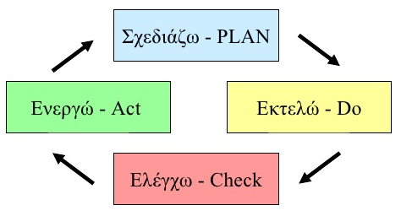
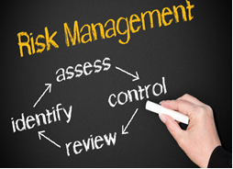
2. Structure & Requirements of Standard ISO 9001:2015
  INTEGRATION OF THE IMPROVEMENT CYCLE & RISK THROUGH THE PROCESS APPROACH
Improvement cycle Plan-Do-Check-Act
Plan: Set the targets of the system and its processes
Do: Implement the plans
Check: Monitor and measure the processes (where applicable)
Act: Take action on performance improvement
Risk implementation

Slide 59
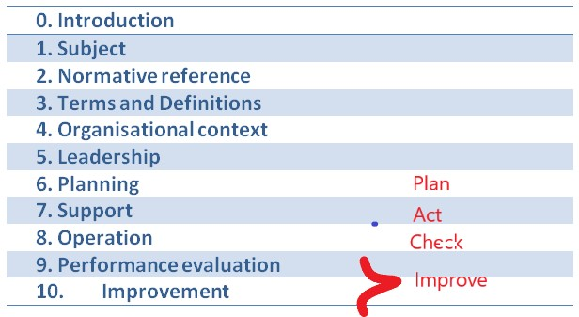
2. Structure & Requirements of Standard ISO 9001:2015
CONTENTS TABLE OF STANDARD EN ISO 9001:2018

Slide 60
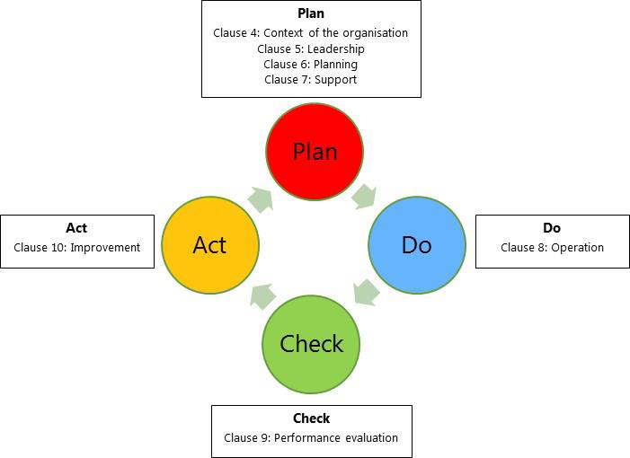
1. Quality management systems (ISO 9001:2015)

Slide 61
2. Structure & Requirements of Standard ISO 9001:2015
  CHAPTER 4: ORGANIZATIONAL CONTEXT
  The Organisation defines and takes into account all external and internal parameters
  Needs and expectations of relevant interested parties
  Definition of the field of the QMS and its processes)
  The QMS implementation field should be documented in writing.
  QMS processes should:
    be defined,
    interact,
    have defined input,
    Have expected output.

Slide 62

2. Structure & Requirements of Standard ISO 9001:2015
  CHAPTER 5: LEADERSHIP
  Senior Management has the responsibility of committing
  In terms of the QMS
  In terms of the personnel
  In terms of the customer
The communication of the Quality Policy as documented written information is a requirement, especially its dissemination to all interested parties.

Slide 63
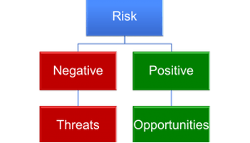
2. Structure & Requirements of Standard ISO 9001:2015
CHAPTER 6: PLANNING
  In the context of risk management, the Organisation should be able to identify the positive results of a risk (opportunities) and the negative results (threats).
  The Organisation should incorporate and implement actions for mitigating threats and exploiting opportunities within the processes of the QMS and evaluate their effectiveness
  Quality Targets – Implementation planning
  Planning of changes to the QMS.

Slide 64
2. Structure & Requirements of Standard ISO 9001:2015
CHAPTER 7: SUPPORT
  The Organisation’s resources comprise of existing internal resources:
    infrastructure,
    staff
    and anything that needs to be sourced from external providers (suppliers.).
  Environment for the implementation of processes
  Monitoring and measurement of resources
  Measurements and the ability to trace them
  Operational knowledge
  Professional adequacy: Staff’s professional adequacy is defined by the Organisation
  Awareness
  Communication

Slide 65
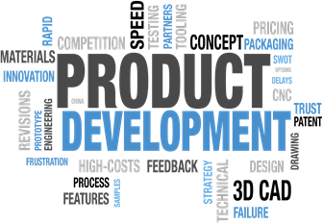
2. Structure & Requirements of Standard ISO 9001:2015
CHAPTER 8: OPERATIONS
  Operations planning and control: At the implementation of processes the Organisation should:
    define the requirements on products and services,
    define the control criteria of its processes and the criteria of approval of its products and services,
    define its resources
    define the auditing of its processes based on the criteria
    keep appropriately evidenced information to the necessary degree
    Monitor the actions of risk management and the Improvement Cycle.

Slide 66
2. Structure & Requirements of Standard ISO 9001:2015
  Communication with the customers.
  Definition of the requirements for products and services. The requirements include:
    Legal and regulatory requirements,
    Requirements defined by the Organisation,
    Requirements defined by the customer.
  Review of the requirements before the release of the product or service.
  Release of the product or service.
  Post-delivery activities (related to warranties and standard obligations)
  Design and development of products and services – Design of suitable processes.
  Planning for the design and development of products and services.

Slide 67
2. Structure & Requirements of Standard ISO 9001:2015
  Design and development control.
  Amendments to the processes for the design and development of products and services.
  Results of the design and development of products and services.
  Production of products and provision of services.
  Audit of production of products and provision of services.
  Identification and tracing.
  Management of non-compliant results. The non-compliant result:
    can be corrected (in this case compliance with requirements must be verified),
    can be separated and secluded,
    Implies informing the customer and authorisation to release the defective product or service,
    can be returned,
    Leads to the cease of the provision of the product or service.

Slide 68

2. Structure & Requirements of Standard ISO 9001:2015
  Audit of products and services provided by external parties
    The Organisation must ensure that processes, services or products provided by external parties (suppliers) do not impact negatively on its ability to offer compliant products and services to its customers.
  Information to external providers
    Within the context of its cooperation with external providers the Organisation should inform them of the requirements governing this cooperation.

Slide 69

2. Structure & Requirements of Standard ISO 9001:2015
CHAPTER 9: PERFORMANCE EVALUATION)
  Monitoring measurement analysis and evaluation.
What should the Organisation do?
It should define:
    What its going to monitor, measure, analyse and evaluate,
    When and with what frequency,
    With which methods..
  Customer satisfaction..
  Analysis and evaluation.
  Internal inspection – It should be conducted at scheduled times in order to evaluate:
    The compliance of the QMS with internal and ISO 9001 2015 requirements,
    The effectiveness of the QMS.

Slide 70
2. Structure & Requirements of Standard ISO 9001:2015
  Review from the Management
  It is planned and executed on the following sectors:
    Effectiveness of actions implemented after previous reviews,
    Changes or improvements to internal and external parameters,
    Customer satisfaction,
    Feedback from interested parties,
    Achievement of quality targets,
    Process performance,
    Compliance of products and services / non-compliance,
    Corrective actions,
    Monitoring and measurement results,
    Internal inspection results,
    Supplier performance,
    Effectiveness of the actions of threat mitigation and opportunity exploitation.

Slide 71

2. Structure & Requirements of Standard ISO 9001:2015
CHAPTER 10: IMPROVEMENT
  The Organisation should implement improvement regarding:
    Meeting product and service requirements,
    Meeting future needs and expectations on products and services,
    Prevention-reduction-elimination of harmful impact on products and services;
    The performance and effectiveness of the QMS.
  Continuous improvement.

Slide 72
2. Structure & Requirements of Standard ISO 9001:2015
Documentation Requirements
  Confirmation of processes and product/services compliance (8.1 )
  Results of the review of product/services requirements (8.2.3)
  Confirmation that design and development requirements are met (8.3.2)
  Results of design and development processes (8.3.5)
  Changes in design and development (8.3.6)
  Results of the evaluation, performance monitoring and re-evaluation of suppliers (8.4.1)
  Product and service characteristics (8.5.1 α)

Slide 73
2. Structure & Requirements of Standard ISO 9001:2015
Documentation Requirements
  Activities executed during the production and provision of products and services and the results achieved (8.5.1)
  Documented information required for traceability (8.5.2)
  Results of the review in products and services, the approving staff and any required actions (8.5.6)
  Traceability of people approving the release of products and services for distribution to the customer (8.6)
  Actions taken for non-compliant processes, products ands services (8.7)
  Results of the monitoring and measurement of activities (9.1.1)

Slide 74
2. Structure & Requirements of Standard ISO 9001:2015
Documentation Requirements
  Evidence on the implementation of the programme and inspection results (9.2.2 στ)
  Management review results (9.3.2)
  Nature of non-compliance, actions taken and action results (10.2.2)

Slide 75
2. Structure & Requirements of Standard ISO 9001:2015
STEPS TO BE UNDERTAKEN

Slide 76
1. Quality management systems (ISO 9001:2015)
If an organization is implementing the standard from scratch, then they need to determine the scope of their QMS and identify the processes and their interactions.
Once the scope of the QMS is defined, the processes and their inter-relationships are then identified.
At this point, the following steps need to be taken:

Slide 77
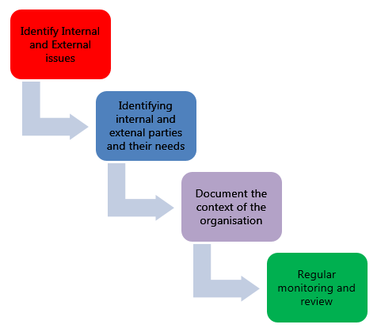
1. Quality management systems (ISO 9001:2015)

