Slide 1





Slide 2
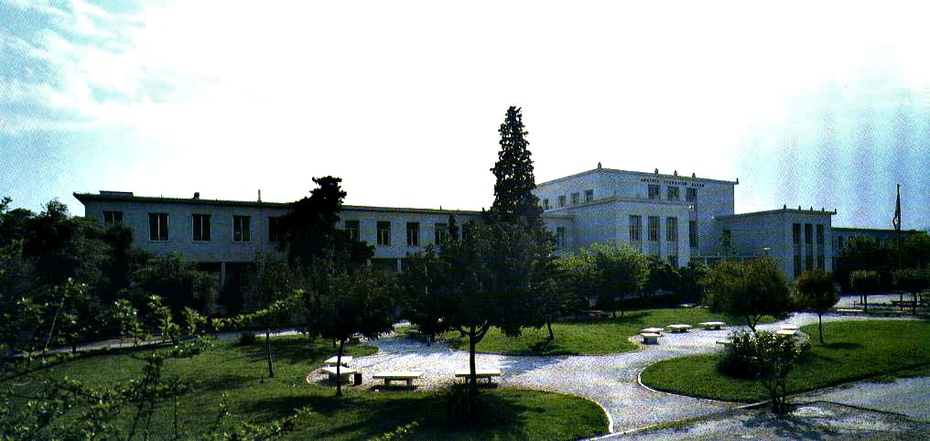

Slide 3
1. Quality management systems (ISO 9001:2015)
A QMS is a tool to help an organisation to manage quality. One thing a QMS isn’t is just the quality manual! (It is not even obligatory any more…) The quality manual is a means of recording how quality is managed within an organisation so everyone does their job in a consistent way, delivering a consistent and quality product or service. In other words, a quality manual reflects the business and the quality management system.

Slide 4
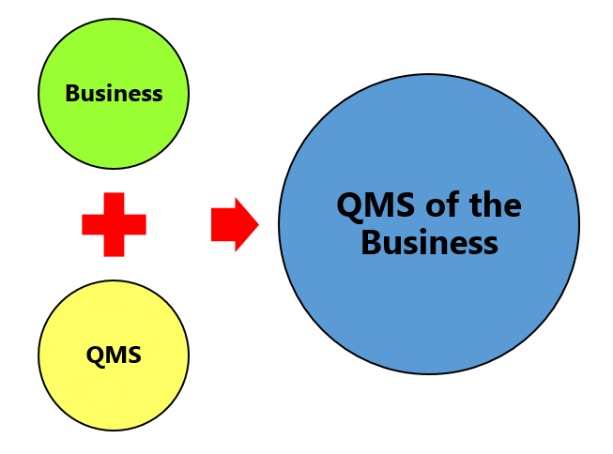
1. Quality management systems (ISO 9001:2015)

Slide 5
1. Quality management systems (ISO 9001:2015)
Plan – Do – Check – Act cycle
The clauses and requirements of the standard are all based on the Plan – Do – Check – Act (PDCA) cycle. PDCA is integral and operates at the process level and at an overall system level.

Slide 6
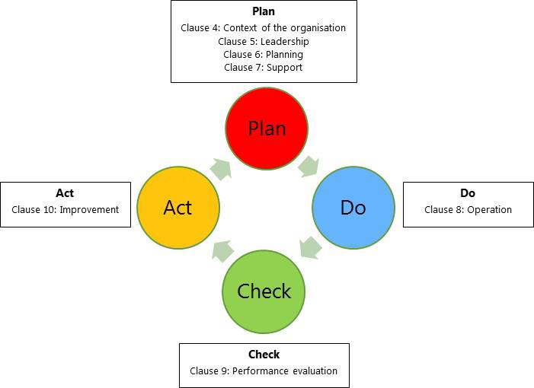
1. Quality management systems (ISO 9001:2015)

Slide 7
1. Quality management systems (ISO 9001:2015)
PLAN: Clause 4 – Context of the organisation
Clause 4.1 - Understanding the organization and its context
If an organization is implementing the standard from scratch, then they need to determine the scope of their QMS and identify the processes and their interactions.
Once the scope of the QMS is defined, the processes and their inter-relationships are then identified.
At this point, the following steps need to be taken:

Slide 8
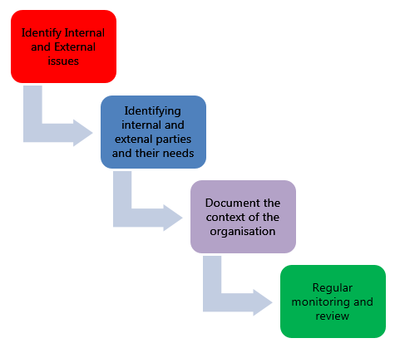
1. Quality management systems (ISO 9001:2015)

Slide 9
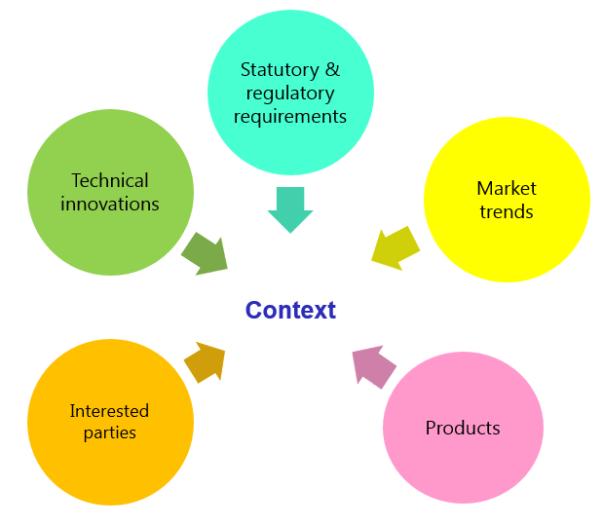
1. Quality management systems (ISO 9001:2015)

Slide 10
1. Quality management systems (ISO 9001:2015)
PLAN: Clause 4 – Context of the organisation
Clause 4.2 - Understanding the needs and expectations of interested parties
The requirements for identifying relevant interested parties means that you need to decide whose opinion your organisation should consider.

Slide 11
1. Quality management systems (ISO 9001:2015)
PLAN: Clause 4 – Context of the organisation
Clause 4.3 - Determining the scope of the QMS
Organisations must clearly define what they sell, including products and services. Link this to the relevant standards that they are governed by.

Slide 12
1. Quality management systems (ISO 9001:2015)
Clause 4.4 - QMS and its processes
Process
The process is a set of interrelated activities that transform activity inputs into outputs. For example, Installation: The process of converting a box of components into a working security system.
Process approach
Process approach is a management strategy that requires organisations to manage its processes and the interactions between them. Thus you need to consider each major process of the company and their supporting processes.

Slide 13
1. Quality management systems (ISO 9001:2015)
All processes have:
inputs
outputs
operational control
appropriate measurement & monitoring
So, for example, a typical alarm company will take enquiries/sales and convert them into working alarm systems.
Below is a block diagram of a typical alarm company processes with support processes and other considerations.

Slide 14
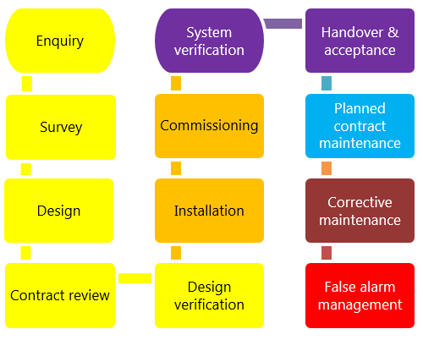
1. Quality management systems (ISO 9001:2015)

Slide 15
1. Quality management systems (ISO 9001:2015)
Questions to ask:
What are the inputs to the process?
Where do the inputs come from?
What are the outputs to the process?
Where do the outputs go to?
Is there an effective inter-relationship between processes?
Who plans the process?
Who conducts the process?

Slide 16
1. Quality management systems (ISO 9001:2015)
Are responsibilities and authorities defined?
Who monitors and measures the process?
What resources are required for the process? - Materials, people, information, environment, infrastructure, etc.
What documented information is required for the operation and control over the process?
What competences & training are required?
What awareness and knowledge is required?
What methods are used to control and run the process?
What are the risks and opportunities for the process?
What happens when the process goes wrong or does not yield the correct output or result?

Slide 17
1. Quality management systems (ISO 9001:2015)
The answers to the questions above form the basis of the process, its control, measurement and improvement.

Slide 18
1. Quality management systems (ISO 9001:2015)
PLAN: Clause 5 - Leadership
Clause 5.1 - Leadership and commitment
Clause 5.1.1 - General
ISO 9001:2015 requires top management to be much more “hands on” with respect to their QMS.
Where the word “ensuring” is used in sub-clause 5.1.1, top management may still assign this task to others for completion.
Where the words “promoting”, “taking”, “engaging” or “supporting” appear, these activities cannot be delegated and must be undertaken by top management themselves.

Slide 19
1. Quality management systems (ISO 9001:2015)
The top management is required to ensure that:
• the requirements set out in ISO 9001:2015 are met;
• QMS processes are delivering their intended outcomes;
• reporting on the operation of the QMS and identifying any opportunities for improvement is taking place;
• a customer focus is promoted throughout the organisation;
• whenever changes to the QMS are planned and implemented, the integrity of the system is maintained

Slide 20
1. Quality management systems (ISO 9001:2015)
Clause 5.1.2 – Customer focus
• Knowing the law and knowing the customer’s expectations and delivering it;
• What can go wrong with what you are selling and providing and what opportunities you also have when you deliver this; opens doors, for example, to other work streams;
• Making sure the customer is happy.
Example: Understanding the customer specification/needs. Ensure you know exactly what the customer wants and documenting this from initial enquiry to commissioning paper work.

Slide 21
1. Quality management systems (ISO 9001:2015)
Clause 5.2 – Policy
Clause 5.2.1 - Establish
Write the policy to include:
• making sure it reflects your business size, ethos and what you are trying to achieve;
• how you will decide what you are going to achieve and how you will check this;
• committing to doing it the right way (e.g. in line with standards and best practice);
• committing to try to continually improve.

Slide 22
1. Quality management systems (ISO 9001:2015)
Clause 5.2.2 – Communicate
Tell everyone about it.
• Making sure it is written.
• Making sure people know it and understand it.
• Giving it to people who have an interest in your business (e.g. clients / suppliers / manufacturers / staff).
• Publishing it on your website.

Slide 23
1. Quality management systems (ISO 9001:2015)
Clause 5.3 - Organisational roles, responsibilities and authorities
• Allocating responsibilities across the organisation to maintain the management system.
• Making sure what is supposed to happen is happening.
• Outcome of the business processes and how it can be improved.
• Remembering customers at all times.
• Remembering to update the system as and when you change how you work or the intended process is amended.

Slide 24
1. Quality management systems (ISO 9001:2015)
Example
Defining job roles prior to recruitment, allocating job descriptions to personnel and linking this to the processes within the business.
A sales administrator might be expected to have 12 months’ experience of writing quotations. When they join there would be a period of training and reinforcing this through a written job description. The output would be a more senior colleague reviewing quotes, confirming they are correct and ensuring that the customer is being quoted for what they asked for. If a form or process is amended along the way advising the sales administrator and ensuring the new versions are applied.

Slide 25
1. Quality management systems (ISO 9001:2015)
PLAN: Clause 6 - Planning
Clause 6.1 - Actions to address risks and opportunities
Clause 6.1.1 - Actions to address risks and opportunities
• When thinking about the business and service delivery, it’s about ensuring that the system you use it right for this. This could include anything from the way in which you sell, to the technology you use in the office.
• Doing extra to make sure the outcome is better than you had hoped for.
• Putting safety measures in place to ensure things don’t go wrong, training for staff, supervision, margins that are realistic which means you can rival your competitor but still remain profitable.
• Actually get better at what you are doing, selling providing, servicing, etc.

Slide 26
1. Quality management systems (ISO 9001:2015)
Example:
Regular site meetings for bigger projects.
Demonstration of calculations and site specification to ensure the engineer installs accordingly.

Slide 27
1. Quality management systems (ISO 9001:2015)
Actions to address the risks – simply understanding what the risks are best capturing this in a business plan.
Plan how all the elements come together, the business plan and how it will be run, and a means of checking these things work and the business plan is on track.
Clause 6.1.2 – Planning for the QMS

Slide 28
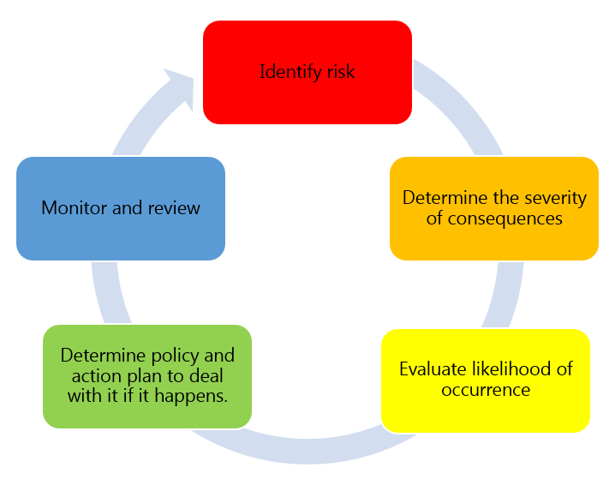
1. Quality management systems (ISO 9001:2015)

Slide 29
1. Quality management systems (ISO 9001:2015)
Clause 6.2 - Quality objectives and planning to achieve them
Ensure that whatever objectives you implement they are SMART
◆ Specific
◆ Measurable
◆ Achievable
◆ Realistic
◆ Time bound

Slide 30
1. Quality management systems (ISO 9001:2015)
Other key rules:
• Make sure they comply with law and industry standards (e.g. don’t cold call out of hours, respond with 4 hours to call outs).
• Make sure they conform with the products and services to make them better.
• Monitored – check what you are doing.
• Tell the staff what they are and what you expect of them.
• Updated when the management change something.
Keep records of this.

Slide 31
1. Quality management systems (ISO 9001:2015)
Clause 6.2.2
Organisations need to clearly understand how these will be realised.
For example, if your aim is to provide national coverage, how will this be achieved? What resources will you allocate, recruiting staff country wide? Who will manage it? Have you understood when it needs to be achieved and what will you do to check it is effective?

Slide 32
1. Quality management systems (ISO 9001:2015)
Clause 6.3 – Planning of changes
When a business changes something, the impact of the change needs to be considered before a change is made. You will need to demonstrate that you have:
a) considered why are you changing it and what could happen when you make the change;
b) ensured that the QMS doesn’t get affected negatively, e.g. something can’t be done any longer once you have changed a process, e.g. you stop recording the number of quotes you are doing and therefore you don’t have an ability to review conversion rates;
c) thought about what you need to achieve it (e.g. people/technology, etc.);
d) considered what changes need to be made in the organisation to make it happen.

Slide 33
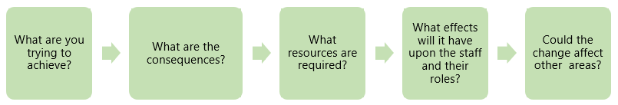
1. Quality management systems (ISO 9001:2015)
Clause 6.3 – Planning of changes

Slide 34
1. Quality management systems (ISO 9001:2015)
PLAN: Clause 7 – Support
Clause 7.1 - Resources
The standard now has a greater expectation for an organisation to consider the resources needed to deliver services and products. There is an expectation to provide a clear understanding of:
what an organisation has in house and whether this is sufficient / fit for purpose to achieve the business plan;
what additional support might be needed externally (e.g. subcontractors that provide specialism outside of their field (e.g. fire, or out of area).

Slide 35
1. Quality management systems (ISO 9001:2015)
Example:
- Specialist skills that are better outsourced due to the size of the organisation (e.g. security screening, health and safety advice).
- Regular meetings to discuss contract and planned work. Include review of type work to ensure that, if the right skills sets aren’t in-house, you get the right subcontract support

Slide 36
1. Quality management systems (ISO 9001:2015)
Clause 7.1.2 - People
This standard expects an organisation to determine and provide the appropriate number of personnel to effectively implement the QMS and for the operation and control of its processes.
Example :Allocation of staff in order to achieve the required outcome. This means determining that you have someone to carry out a specific process (e.g. recruitment, screening and training of staff). Dependent on the size of the organisation this may be one or two people or a team. The senior management will need to determine the resource needed and maintain this.

Slide 37
1. Quality management systems (ISO 9001:2015)
This will be about ensuring you have the right number of engineers or security officers to provide the service that you have quoted. This will depend on the specifics set out in the contract and terms. (e.g. ensuring you have sufficient engineers to respond within 4/24 hours. Ensuring you have sufficient trained security officers to replace those who may be sick or on holiday).

Slide 38
1. Quality management systems (ISO 9001:2015)
Clause 7.1.3 – Infrastructure
Essentially a company needs to consider all the things they will need in order to deliver a service/product to the customer/client. This needs to include:
• buildings / water / gas / electric, etc.;
• equipment - for example computers / operating systems (e.g. alarm master);
• vehicles – for engineers / management / sales and survey staff;
• information – standards that have to be applied, mobile phones / tablets, etc.

Slide 39
1. Quality management systems (ISO 9001:2015)
Clause 7.1.4 - Environment for the operation of processes
The standard now specifically makes reference to the environment that you work in.
Equality Opportunities / whistleblowing / anti-bullying policy
Violence at work / counselling support / lone working
Office based risk assessment, space, noise levels

Slide 40
1. Quality management systems (ISO 9001:2015)
Clause 7.1.5 - Monitoring and measuring resources
The organisation needs to decide what tools it uses to measure business performance. It also needs to consider whether these tools will give them everything they need as a result.
Example:
Install
Customer Service – feedback after install – via phone call. Other organisations may have a CRM in place.

Slide 41
1. Quality management systems (ISO 9001:2015)
Suitable measuring tools?
Equipment that is used to test and commission systems such as multimeters, insulation testers, sound pressure level meters, etc.
Maintained – calibration of all the test equipment that you use.

Slide 42
1. Quality management systems (ISO 9001:2015)
Clause 7.1.5.2 - Measurement traceability
You need to establish whether this is relevant to you and meeting all applicable requirements for the product and services. How do you determine this?
• Is it required to be calibrated?
• Allocated unique reference numbers and listed on a register of some sort.
• Allocated to personnel as and when needed and a clear process in place to ensure all staff know how to use it properly

Slide 43
1. Quality management systems (ISO 9001:2015)
Example
Maintenance Register should be in place. Sampling of commissioning paperwork to ensure the readings are consistent with expectations and or parameters set.
Note:
Organisations expected to check results from calibration to ensure they are comfortable they have not been tampered with.

Slide 44
1. Quality management systems (ISO 9001:2015)
Clause 7.1.6 - Organisational knowledge
Leaders in the business have to decide what skill sets staff need in order to fulfil their business plan. This includes knowledge of products and services they are selling. This would best be captured in a skills and or training matrix to demonstrate a clear understanding.
If the business decided to change its direction or perhaps move into another area, e.g. installing Fire systems, they will need to document that they have identified which skills they may be missing or where those skills lie to ensure they are in place to move into this area.
Example : An organisation may decide to go into fire installation so will need fire surveyors / designers / engineers / understanding of fire standards, etc. before they can proceed.

Slide 45
1. Quality management systems (ISO 9001:2015)
Clause 7.2 – Competence
Determining competence is a necessity in any organisation. Working out the skills your team has and skills they don’t yet have. Skills they will need to achieve the company’s objectives.
Example: Increase in sales = need for additional trained surveyors.

Slide 46
1. Quality management systems (ISO 9001:2015)
Clause 7.3 – Awareness
Note: This is a new requirement.
There is greater focus on not just communicating the policy but ensuring that it is understood, how it affects work, especially if they deviate from it. Staff should understand what they contribute and how this can make the business better.
From a QMS point of view, businesses should look to explain policies more clearly so that staff understand their meaning.

Slide 47
1. Quality management systems (ISO 9001:2015)
Clause 7.4 - Communication
This is a straightforward clause and is simply about effectively communicating to all those within the business and those affected by it.
Internal communications:
Briefings to staff on:
• new policies;
• new or amended objectives;
• new of amended strategies;
• new clients;
• new or amended technology;
• new products;
• issues with suppliers;
• anything that will have an impact on them
Designate person responsible for updates: either department heads, leaders in the business.
External communications: Allocation of key account managers. Implement review meetings, etc.

Slide 48
1. Quality management systems (ISO 9001:2015)
Clause 7.5 – Documented information
This refers to what is needed for the QMS. What does this mean? It means in order to prove that you are working a QMS that you need to evidence it.
How can you demonstrate that you understand something unless there is evidence? You could explain it but it is far easier to write the system around your business and business processes so that you are evidencing it as a part and parcel of the way you operate.
Remembering that to the extent necessary:
a) maintain documented information to support the operation of its processes (i.e. procedures, etc.);
b) retain documented information to have confidence that the processes are being carried out as planned (i.e. records).

Slide 49
1. Quality management systems (ISO 9001:2015)
Clause 7.5.2 – Creating and updating
Documents that you use as a business should have clear document control. You will already be used to doing this.
It also expects a clear format and for it to be approved. This is to prevent anyone just using documents that they see fit. It seems slightly unnecessary when you are a SME as there may be a very small team or even 1 of you. For larger businesses this is really important so that documents are used properly and changes that have been incorporated for the good don’t get lost when someone else doesn’t understand them or removes them.

Slide 50
1. Quality management systems (ISO 9001:2015)
Clause 7.5.3 - Control of documented information
Businesses are required to ensure that they make sure whoever needs a document/template has access to it and it is right one. There is also a reminder that lots of business documents have confidential info such as:
• addresses;
• prices (which in the hands of competitors is unhelpful);
• secure info about a client’s site (which could be used improperly in the wrong hands).

Slide 51
1. Quality management systems (ISO 9001:2015)
Clause 7.5.3.2
Businesses need to ensure they:
a) make sure everyone who needs info can get to it easily
b) that certain documents are kept for a period of time. Most businesses would naturally do this in any case but this standard refers to it specifically. There is also an expectation that whatever documents are kept as records you can get hold of them as and when you need to.

Slide 52
1. Quality management systems (ISO 9001:2015)
DO: Clause 8 – Operation
Clause 8.1 - Operational planning and control
Clause 8.1 - Operational planning and control
Businesses are expected that, once they have done their planning for what they are going to sell, they then plan the detail of how this can be done operationally.
• Set up supplier accounts / trade accounts.
• Purchase stock.
• Ensure staff have correct skills and understand the process.
• Purchase tools and vehicles.
• Make sure you have enough staff.
• Issue clear instructions, drawings, procedures risk assessments to enable them to do the job.

Slide 53
1. Quality management systems (ISO 9001:2015)
Clause 8.2 - Requirements for products and services
Clause 8.2.1 - Customer communication
This is essentially about what how you relate to the customer, to include:
a) what you are selling;
b) how they can expect to be dealt with (e.g. formal quote / email / letter / terms you will work under/within);
c) getting feedback from the customer;
d) looking after their property (e.g. premises whilst you are in there);
e) what plans you put in place for if something goes wrong.

Slide 54
1. Quality management systems (ISO 9001:2015)
Example :
Ensuring the customer has a clear written quotation and specification relating to the services they want. Allocating a specific person/manager to the customer so that they have one key contact for all communication; that way, positive and negative feedback is captured and dealt with.

Slide 55
1. Quality management systems (ISO 9001:2015)
Clause 8.2.2 - Determining the requirements for products and services
Organisations need to be clear about what is required in order to sell their products and services:
􀁸 for legal and industry norm;
􀁸 elements the organisation determines as necessary for their own needs.
The organisation must be able to deliver what it is selling.
Example: Liaise with suppliers, attend open days, read product literature.

Slide 56
1. Quality management systems (ISO 9001:2015)
Clause 8.2.3 - Review of the requirements for products and services
Clause 8.2.3.1 Organisations are expected to review whether they can provide what they intend to sell. This review must include taking into account:
a) what the customer orders, the install and any after work, e.g. maintenance / follow up / servicing;
b) elements that need to be completed to ensure the job is fitted correctly
c) anything else the company need to implement
d) legal and industry standards
e) Any variations

Slide 57
1. Quality management systems (ISO 9001:2015)
Example :
Can a search be done by the same sex staff if the staffing levels do not support this?

Slide 58
1. Quality management systems (ISO 9001:2015)
Clause 8.2.3.2
Reviews must be documented. How?
If they want to use new products and services, this should be captured. Customers should be made aware of the impact of changing products and services, etc.
Example:
For systems organisations, a contract review should be in place either using paper or electronic documents, confirmation emails, quote proposals, etc. In addition, capturing any change to technology you might use on the site (e.g. change of DVR and making them aware of this).

Slide 59
1. Quality management systems (ISO 9001:2015)
Clause 8.2.4 - Changes to requirements for products and services
If any orders change, this needs to be tracked and documented.
Example:
Someone in the organisation who is responsible for stock and install needs to ensure these two elements are aligned.

Slide 60
1. Quality management systems (ISO 9001:2015)
Clause 8.3 - Design and development of products and services
Clause 8.3.1 - General
This clause is new and it requires an organisation to introduce design and development process. What does this mean?
Previously, when design was not relevant as you provided a service, that this needs to be considered even if you do not make the products. The fact you are designing a system means you need to consider all the elements of design.

Slide 61
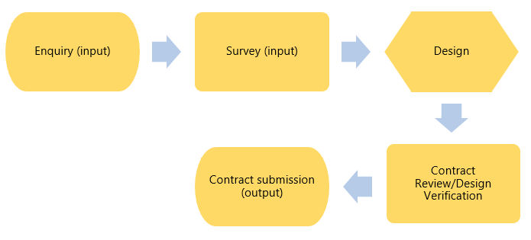
1. Quality management systems (ISO 9001:2015)

Slide 62
1. Quality management systems (ISO 9001:2015)
Clause 8.3.2 - Design and development planning
This is a list of items an organisation needs to include when designing:
• How long will it take to survey / design / what surveying skills are needed?
• Who should review the design? Who can confirm it is right?
• What needs to be done to check it is right?
• Who would be responsible?
• Resources needed from the company and any subcontractors.
• Ensuring all involved communicate (e.g. surveyor and designer and administrator).
• Checking that what you are designing is what the customer wants.
• What other things are needed – products and services?
• Control needed to ensure it goes to plan, from customers and interested parties (e.g. subcontractors / manufacturers / monitoring stations)
• Documenting that the above has been considered

Slide 63
1. Quality management systems (ISO 9001:2015)
Additional requirements to be considered:
• Design or development failure.
• Standards and/or codes of practice
Clause 8.3.3 - Design and development inputs
Design inputs = what needs to be considered to design

Slide 64
1. Quality management systems (ISO 9001:2015)
Clause 8.3.4 - Design and development controls
There are no new requirements for this.
Continue to verify what has been installed and validate – check and test.
Clause 8.3.5 - Design and development outputs
The organisation is expected to determine what they need to do to check the design.
‘monitoring and measurement requirements’
documented information required = evidence

Slide 65
1. Quality management systems (ISO 9001:2015)
Clause 8.3.6 - Design and development changes
This is unchanged from before but expects organisations to control the change not just let the change happen.
Info on the design and development changes.
Results of review – record changes to schematics.
Who agreed any changes?
Controls to stop things being done incorrectly.
Example : A guarding customer decides he wants 3 more patrols a shift; can this be achieved with the resources allocated?

Slide 66
1. Quality management systems (ISO 9001:2015)
Clause 8.4 - Control of externally provided processes, products and services
The organisation needs to consider the impact of suppliers on what they provide the customer and how it may reflect if something goes wrong when the recommend a product.
Example
Manufacturers that you have been using go out of business, are suddenly unable to supply goods or replace products installed that have become faulty.

Slide 67
1. Quality management systems (ISO 9001:2015)
Clause 8.4.1 – General
This clause is about ‘external’ influences and control of it namely supplier/subcontractors.
New requirement to monitor performance levels. Most companies would already do this in a form of aKPIs.
Companies should consider explicitly stipulating what they want from a subcontractor and or supplier.

Slide 68
1. Quality management systems (ISO 9001:2015)
Corrective maintenance – 4 hour response
Suppliers – Delivery of critical goods in 24 hours
Evidence would include:
• Delivery reports • Performance measures • Check call reports • Screening progress reports
Example

Slide 69
1. Quality management systems (ISO 9001:2015)
Clause 8.4.2 - Type and extent of control
This clause is about ensuring that suppliers and subcontractors are well managed. Needs to be detailed in the QMS and clear post delivery activities defined, which means defining
Purchasing process is impacted here and this needs to be extended from just supplier approval process to what it means once they start delivering, what your expectations are, etc.
Example: Supplier approval agreements to be in place before they start work for you – essential. Checks on insurance, screening, etc.

Slide 70
1. Quality management systems (ISO 9001:2015)
Clause 8.4.3 - Information for external providers
This is about ensuring that third party suppliers and subcontractors have a clear understanding of what they are expected to supply.
Example:
Processes for subcontractors
May include training / tests
Also expects you to check the competence of the personnel a subcontractor is using

Slide 71
1. Quality management systems (ISO 9001:2015)
Clause 8.5 - Production and service provision
Clause 8.5.1 - Control of production and service provision
Documented information – must be available to record activities undertaken and results.
Monitoring and measurement is now no longer just about test results / meter readings but checks that personnel may undertake such as human checks.
Should have info that describes the product – specification / manufacturers guidance / quotation.
Define what the customer wants (e.g. intruder system).
Ensuring that you have what you need to measure and test systems installed.

Slide 72
1. Quality management systems (ISO 9001:2015)
Define what tests should be done and when (e.g. test electric output before, during and after install).
Make sure that you have the right support from the office and site to complete the job this could be as simple as someone ordering the right part for you to be delivered to site.
Competent and trained staff.
A clear process to test and check the install is as should be during delivery so that you know that when it’s done it was done correctly.
Safety measures to prevent mistakes taking place.
Process required when an install is complete.

Slide 73
1. Quality management systems (ISO 9001:2015)
Clause 8.5.2 - Identification and traceability
This clause is unchanged. There is a need for all organisations to be able to track their clients, the services they provide, the products they install. This clause is expecting organisations to apply a rationale to this and ensure it is well applied. Companies should be able to rely on the process and be confident that it is consistently applied.
Example A unique reference number to clients’ quotes and variations to such.

Slide 74
1. Quality management systems (ISO 9001:2015)
Clause 8.5.3 - Property belonging to customers or external providers
There is an expectation that any property belonging to a client, third party, supplier, etc. the organisation is involved with they have a clear process for protecting it. This may well be that written but it is essential that the organisation regard the following as property and as such protect it:
• Intellectual info such as data / addresses / prices.
• Materials.
• Tools equipment.
• Customer keys.

Slide 75
1. Quality management systems (ISO 9001:2015)
For example, you may have a team of contractors working on a site who bring their own equipment. There should be a clear and understood process on how this is managed even if it is stipulated that they are responsible for their own tools.

Slide 76
1. Quality management systems (ISO 9001:2015)
Clause 8.5.4 - Preservation
This is a requirement to ensure that the supply of services are protected so that what is supposed to be achieved is.
Example: Ensuring that products delivered to site are not damaged and are delivered when an engineer is on site to receive it.
.

Slide 77
1. Quality management systems (ISO 9001:2015)
Clause 8.5.5 - Post- delivery activities
Note: This is a new clause.
This is about post delivery, so what a company should do after they have supplied a product or a service.
Companies need to think about things that could go wrong which could impact what they have installed.
This new requirement needs to be added into the QMS.

Slide 78
1. Quality management systems (ISO 9001:2015)
Must take into account:
- legal and industry standards
things that could go wrong
- how products should be used and how long they should last
- customer expectations
customer feedback
Consider risk levels
Examples:
Terms and conditions / warranties

Slide 79
1. Quality management systems (ISO 9001:2015)
Clause 8.5.6 - Control of changes
Note: This is a new clause.
There is a clear expectation that when an organisation wants to or has to make a change to a process in the business then they document this change. Why have they made it? What impact did it have? What are the implications for staff and customers?
Example A company expands and decides to separate the enquiry & sales department from the design department. What are the impact? How will the new interactions between departments operate effectively?

Slide 80
1. Quality management systems (ISO 9001:2015)
Clause 8.6 - Release of products and services
No change for this clause. Just ensure you implement checks that the product and service is delivered as expected
(e.g. commissioning paperwork, customer satisfaction / feedback and signatures).

Slide 81
1. Quality management systems (ISO 9001:2015)
Clause 8.7 - Control of nonconforming outputs
Clause 8.7.1
You do not need a documented procedure any longer to detail how you will deal with things that go wrong but you do need to do the following:
a) Fix it.
b) Remove it if necessary.
c) Tell the customer.
d) Ask them to accept it.

Slide 82
1. Quality management systems (ISO 9001:2015)
Clause 8.7.2
You should record what you do when things go wrong:
About what is wrong
b) What you did as a result
c) What concessions you gave (e.g. did the customer accept it but you altered the cost?)
d) Who had the authority to make the change.

Slide 83
1. Quality management systems (ISO 9001:2015)
Example
Handover documentation signed by the client needs to ensure that a change is tracked and that you may need to revisit to rectify of that the client accepts the modification.
Guarding organisations may track this through contract review meetings.

Slide 84
1. Quality management systems (ISO 9001:2015)
CHECK: Clause 9 - Performance evaluation
Clause 9.1 - Monitoring, measurement, analysis and evaluation
Note: This is a new clause.

Slide 85
1. Quality management systems (ISO 9001:2015)
Clause 9.1.1 - General
This expects all organisations to identify what they need to monitor and measure or check and review to ensure that what they are delivering is how it should be.
The business plan defines what the company wishes to achieve whether this is written or not. Based on this, each company should have an understanding on the risks that go alongside it whether this be based on growth, moving into a new area of expertise, using a new product. The organisations should consider all these things when deciding what they think needs monitoring.

Slide 86
1. Quality management systems (ISO 9001:2015)
Example: If you are working in a new field, e.g. install of access systems, and have new staff with limited experience, then operationally this is a higher risk and perhaps may need monitoring more closely than those engineers who have been installing intruder alarms for many more years.

Slide 87
1. Quality management systems (ISO 9001:2015)
So decide:
a) what you monitor and measure;
b) how you will do it effectively;
c) when you expect it to be done, at the end of a job, mid-way through, beginning of the recruitment process;
d) what you do with the results to check the business is working as it should be.
You need to keep records of this.
What if you have just started and have no evidence as yet? This is accepted but should have a clear understanding of what these are for the future and be able to show the measures that you will be used.

Slide 88
1. Quality management systems (ISO 9001:2015)
Example:
Planned records of the evaluation, training and competence of staff.

Slide 89
1. Quality management systems (ISO 9001:2015)
Clause 9.1.2 - Customer satisfaction
There continues to be a need to obtain feedback from customers on whether they feel the product and service they have purchased was as they expected. Organisations need to decide how they will do this and record the information they receive. How are you going to gather this information?
Example : -You may receive complimentary letters, emails, social media postings, etc.
- There are indirect methods such as repeat business, recommendations and referrals.

Slide 90
1. Quality management systems (ISO 9001:2015)
Clause 9.1.3 - Analysis and evaluation
All companies already measure and carry out some form of analysis but there is now an additional requirement to evaluate the data.
There are some key expectations:
• Ensure the data is used to check what you sell is as it should be.
• How happy are your customers?
• How well did the company perform?
• Did it go to plan or were there hiccups along the way?
• Safety measures put in place – did they work?
• Did subcontractors perform as you expected?
• What do you need to change now to make the QMS better?

Slide 91
1. Quality management systems (ISO 9001:2015)
Clause 9.2 - Internal audit
There continues to be a need to carry out internal audits and to do it effectively.
Clause 9.2.2
There is no need for an internal audit procedure but it may be useful to keep it. You do need to define audit criteria.
There is no more detail on the arrangements expected for carrying out internal audits. Not significantly different but more emphasis on how they are done, how they are feedback and now a clear reference to audits being corrected in a reasonable time to fix non-conformances identified. Ensuring that all the right people are included in the audit outcome.

Slide 92
1. Quality management systems (ISO 9001:2015)
Clause 9.3 - Management review
Clause 9.3.1 - General
Consider the QMS and ‘alignment’ with the strategic direction of the business. This essentially means ensuring that what the organisation has determined that they want to achieve the QMS will help this happen.

Slide 93
1. Quality management systems (ISO 9001:2015)
Example
Most organisations work to a business plan whether this is written or not and the direction of the business should be developed into the QMS.
If a business decides it wants to grow, e.g. in guarding, keyholding, install of fire systems, then the QMS needs to be equipped to deal with this. It might be you decide that quotations for this work will be completed more quickly than others, or that you will seek out tenders of this type to support the business strategy and this should come through the QMS.

Slide 94
1. Quality management systems (ISO 9001:2015)
Clause 9.3.2 - Management review inputs
Key differences:
• Refers to external issues as well as internal ones (though this was always implied).
• Effectiveness of actions taken to address risk and opportunities.

Slide 95
1. Quality management systems (ISO 9001:2015)
Example
A customer may becoming slow in paying you and this may indicate that the company is in trouble and you should consider how you will manage this and at what point you intervene or cease service.
A customer may becoming increasingly demanding, expecting management attendance at meetings that outweigh the benefit of the contract. How do you manage this?

Slide 96
1. Quality management systems (ISO 9001:2015)
Clause 9.3.3 - Management review outputs
The outputs required remain the same. Ensure that there is:
a) opportunity to improve;
b) changes needed for the QMS to achieve this;
c) resources.
There is now a clearer reference to keeping documents to demonstrate the review took place as opposed to minutes of it.

Slide 97
1. Quality management systems (ISO 9001:2015)
-
Examples
-A contract with ongoing complaints starts to improve with customers KPI’s improving
Debtors reducing month by month
-Reducing management time by introducing electronic reporting
-Targeting a new scope of work and allocating enough admin staff to turn around quotes within the new targets set

Slide 98
1. Quality management systems (ISO 9001:2015)
ACT: Clause 10 - Improvement
Clause 10.1 - General
Note: This is a new clause.
There is now a requirement for organisations to focus clearly on customer satisfaction and customer needs, not only that but to look for ways to improve:
a) products and services, now and for the future;
b) fixing and controlling business issues to reduce things going wrong;
c) improving the QMS.
No requirement for a procedure on preventive action. This term is removed.

Slide 99
1. Quality management systems (ISO 9001:2015)
Examples:
-Clear customer documentation is key here to ensure that their expectations are managed. Check customers’ understanding periodically - do not assume ‘no news is good news’ they may be thinking they need something else and are testing the marketplace.
-Look at ways of improving the processes within the organization, do they add value, can they be done more efficiently, e.g. by moving away from paper systems so that customers can be sent reports immediately?

Slide 100
1. Quality management systems (ISO 9001:2015)
Clause 10.2 – Non-conformity and corrective action
Clause 10.2.1
When something goes wrong you must:
a) react to it:
1) do something / take action / fix it;
2) deal with the impact it had (e.g. upset customer).
b) evaluate what went wrong to prevent it happening again and check there are not other similar issues that could happen.
Key now is to update risks and opportunities.

Slide 101
1. Quality management systems (ISO 9001:2015)
Clause 10.2.2
Note: This is a new clause.
Keep records of all non-conformities, what you did to resolve them, implement additional measures, etc.
No requirement for a corrective action procedure now.
Example Non-conformance has been identified during an installation / customer visit. Make notes of what went wrong, e.g. insufficient cable provision, additional needs to be purchased, does this impact the length of the job, the client impact, etc. and the cost / time?
Amend assignment instructions to reflect the change.

Slide 102
1. Quality management systems (ISO 9001:2015)
Clause 10.3 - Continual improvement
There is now a clearer expectation for organisations to use data from monitoring and measuring to review the business performance and that of the QMS. Organisations should be clear to use this information, by analysing it and ensuring that the QMS is adequate for the organisation.

Slide 103
1. Quality management systems (ISO 9001:2015)
Example
Minutes of meetings would detail that actions have been taken and that improvements have been made. For some organisations, they may have charts and trend analysis in place that highlights positive trends, e.g. staff retention has improved, sales conversion has increased, customer complaints have declined, profitability is growing.
Directors and senior management should be able to review these top levels results and have a good understanding that improvement is taking place and/or is planned

Slide 104
1. Quality management systems (ISO 9001:2015)
Quality management systems — INTERNATIONAL STANDARD ISO/FDIS 9001 Requirements, ISO/TC 176/SC 2, 2015, Final Draft
Quality management principles - ISO.Org, 2012
NSI, Annex A to 9001:2015 Guidance document for approved companies, A step by step guide on how to interpret each clause, June 2016
References
•American Society for Quality. Plan–Do–Check–Act Cycle. http://www.asq.org/learn-about-quality/project-planning-tools/overview/pdca-cycle.html
•asq.org/learn-about-quality/iso-9000/overview/quality-management-principles.html

